Slide 1

Group 10
Predicting Hospital Readmission

Slide 2
Team Members
01
Madhusudan Singh
02
Swati Agarwal
03
Raj Chandel
04
Deepak Pathak
05
Amit Saraswat

Slide 3
Introduction
Objective: To develop a predictive model that identifies patients at risk of readmission within 30 days post-discharge.
Importance: Early identification allows for targeted interventions, improving patient outcomes and reducing healthcare costs.
Scope: This project focuses on developing, evaluating, and deploying a machine-learning model in a hospital setting.

Slide 4
Problem Statement :
﻿Literary Review
Challenge: High rates of hospital readmissions contribute to increased healthcare costs and can indicate inadequate patient care.
Goal: Develop a model to predict the likelihood of patient readmission, enabling proactive care management.

Slide 5
﻿Research Methods
Sources: Electronic Health Records (EHRs), hospital databases, and patient surveys.
Data Types:
Patient Demographics: Age, gender, ethnicity.
Clinical Data: Diagnoses, comorbidities, medications, procedures.
Hospital Data: Length of stay, previous admissions.
Socioeconomic Data: Insurance status, income, social support.

Slide 6
﻿Research Methods
Data Preprocessing
Steps:
Data Cleaning: Handling missing values and outliers.
Feature Engineering: Creating new features (e.g., number of previous admissions).
Normalization/Standardization: Scaling features for uniform contribution.
Encoding Categorical Variables: Converting categorical data into numerical formats.

Slide 7
﻿Research Methods
Technology Stack
Programming Language: Python
Libraries:
Pandas: Data manipulation and analysis.
Scikit-learn: Model development, training, and evaluation.
NumPy: Numerical computations.
Matplotlib/Seaborn: Data visualization.

Slide 8
﻿Research Methods
Conclusion:
Conclusion
Summary: This project aims to predict hospital readmissions using a Logistic Regression model implemented in Python with Pandas and Scikit-learn.
Next Steps: Begin with data collection and preprocessing, followed by model development and deployment.

Slide 9
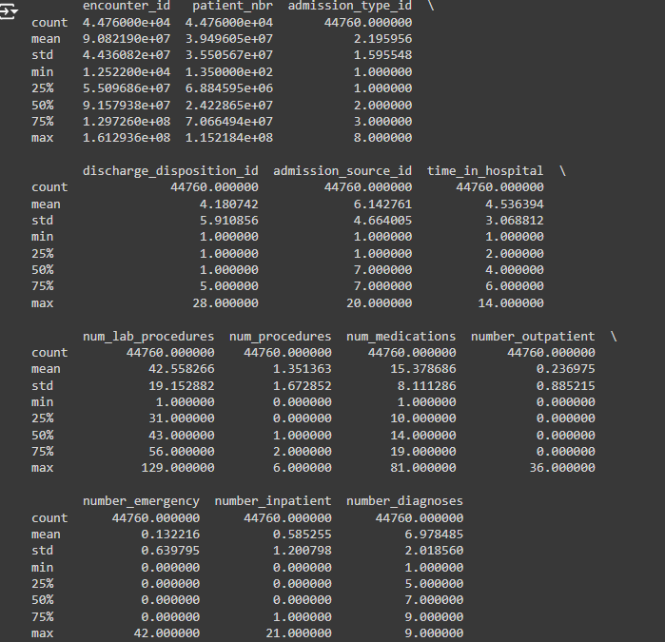
Model Data:

Slide 10
Thank You
by G-10

